Slide 1

ATTENDANCE SYSTEM USING FACE RECOGNITION
Praniv Warungshe 21104031
Siddhi Desale 21104135
Sushant Mhatre 21104002
Project Guide
Ms. Geetanjali Kalme

Slide 2
Contents
Introduction
Objectives
Scope
Literature Survey
Features / Functionality
Technology Stack
Block Diagram
Use Case/DFD
Suggestions in Review-1
Result and Discussion
Conclusion and Future Scope
References

Slide 3
1. Introduction
An Attendance System using Face Recognition is a technology that automates the process of tracking attendance by identifying individuals through their facial features.
Problem Identified :
Offline attendance systems delay real-time data access.
Offline systems rely on error-prone manual data entry.
Physical attendance records has risk of loss, damage, and theft.
Solution Proposed
Face recognition for automated data entry.
User Friendly Interface for Users.

Slide 4
2. Objectives
To develop a robust attendance system capable of accurately recording attendance using face recognition.
To integrate face recognition technology using machine learning algorithms to identify and authenticate individuals for attendance logging.
To implement face recognition functionality for seamless attendance tracking
To design a user-friendly interface for both administrators and users, facilitating easy navigation and interaction with the attendance system.

Slide 5
3. Scope
Can be applied in educational institutions such as schools, colleges, universities, and training centers.
Suitable for events, conferences, and workshops where attendance tracking is required.
Can be implemented in corporate environments for tracking employee attendance.
Can benefit instructors, teachers, and administrators by automating attendance management processes.

Slide 6
4. Literature Survey
Sr.No | Title of Research paper | Authors | Publication Years | Technology Stack | KeyFindings
1. | "Smart Attendance System Using Machine Learning" | Prof. Shweta S Bagali, Dr K Amuthabala, Prof. Iranna Amargol, Mr H Prajwal | 2022 | Computer Vision, Machine Learning, Face Recognition,Dot Net | -Utilizes histogram-arrangedslopes, supportvector machines,and deep convolutional networks for facial recognition -Develops a real-time face detection and attendance marking application -Integrates with Dot Net APIs for camera input

Slide 7
4. Literature Survey Continued
Sr. No | Title of Research paper | Authors | Publication Years | Technology Stack | KeyFindings
2 | "Evaluation of Attendance Tracking Systems: Face Recognition " | Patel, S. and Lee, K. | 2022 | Java, Spring Boot, OpenCV, ZXing | - Face recognition systems offer higher accuracy but require more computational resources. .
3 | "Comparing the Efficiency of Face Recognition and QR Code Attendance Systems" | Garcia, M.etal. | 2021 | C++, OpenCV, Python, Django, QR Code API | -Face recognition systems show higher user acceptance due to convenience. -QR code systems are simpler to implement and maintain in various environments

Slide 8
5. Feature/Functionality
User Interface:
1.Develop an intuitive and user-friendly interface for users.
Face Recognition:
1.Implement a face recognition system using cameras.
2.Capture and store facial features securely for enrolled users.
Face Enrollment
1.Users can capture multiple images of their face from various angles to create a robust facial recognition model for enrollment into the system.

Slide 9

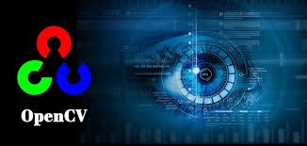

6. Technology Stack
Frontend:- Html,css,js
Database:- Excel,OpenCv,Mysql
Backend:- Python,Flask,PhpMyAdmin,OS
Libraries:- Pandas,Numpy,Sklearn,OpenCv
Algorithms:-
Haarcascades
Open cv
Knn

Slide 10
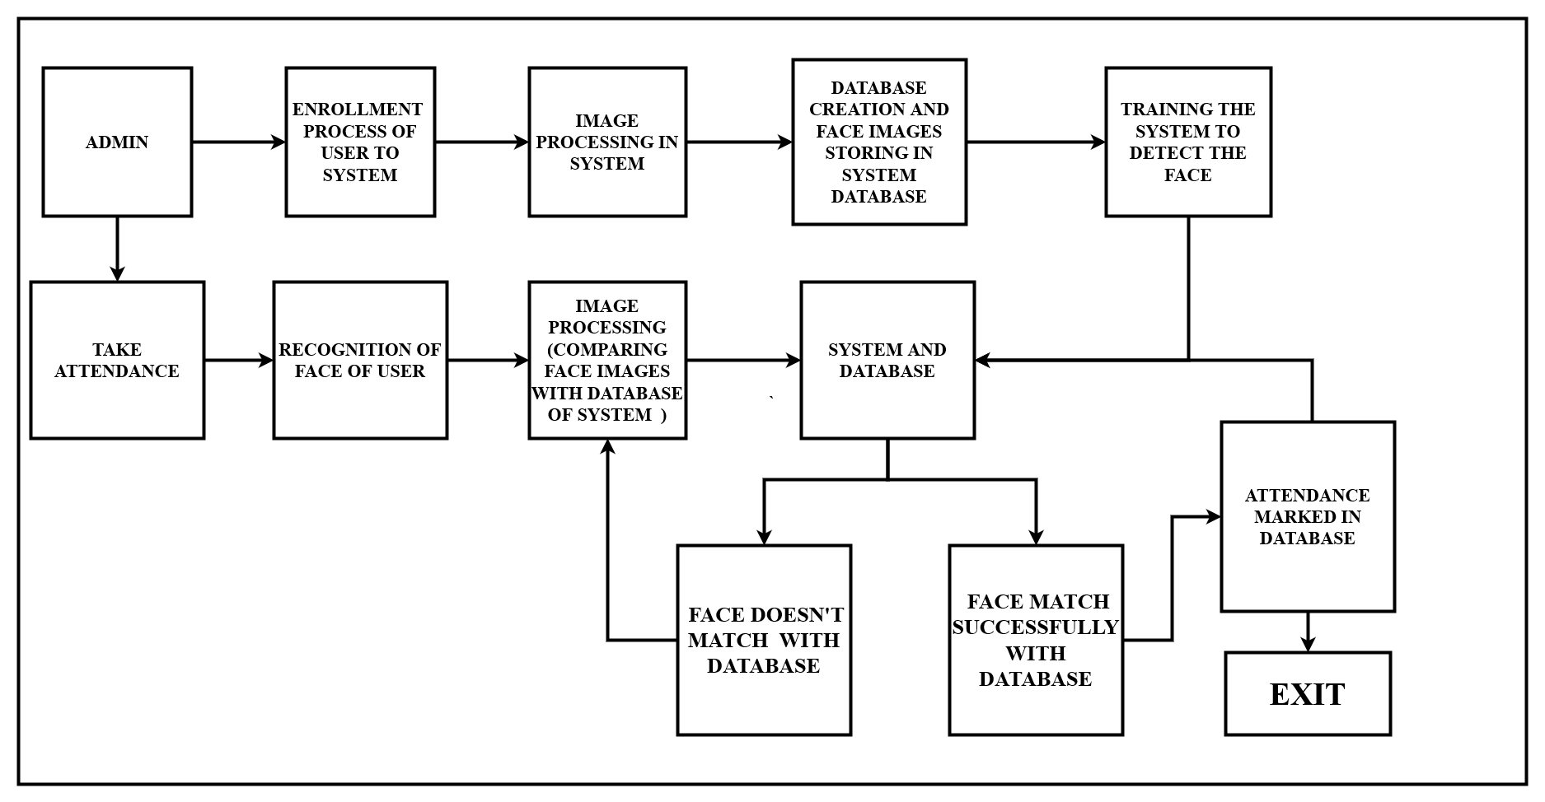
7. Block Diagram

Slide 11
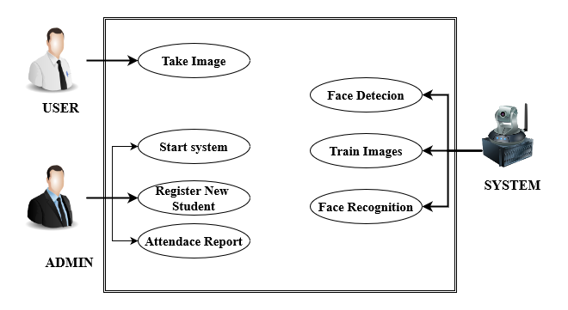
8. Use Case

Slide 12
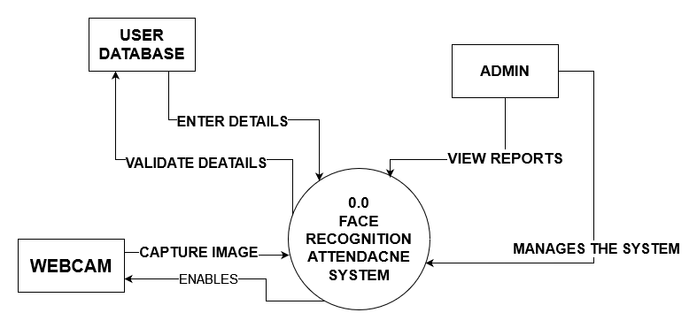
DFD LEVEL 0

Slide 13
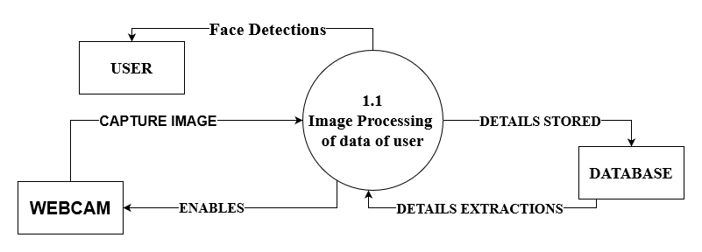
DFD LEVEL 1

Slide 14
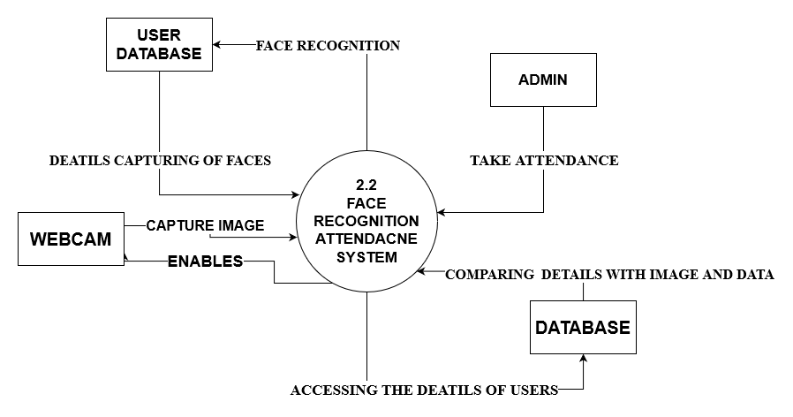
DFD LEVEL 2

Slide 15
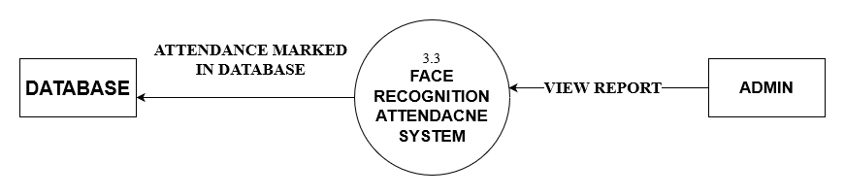
DFD LEVEL 3

Slide 16
9. Suggestion in Review 1
1. Listing libraries of algorithms in ppt.
2. Research paper should be use as to be latest or last 3 years.
3. Changing the font and font size.

Slide 17
10. Result and Discussion
1. Efficiency: Automation of attendance tracking through face recognition reduces the need for manual entry or barcode scanning, saving time and effort for both employees and administrators.
2. Real-time Tracking: The system can record attendance in real-time as employees or individuals pass through the recognition point, providing up-to-date information for monitoring attendance patterns.
3. Reduced Fraud: Face recognition systems are difficult to circumvent compared to traditional methods like badge swiping or manual sign-ins, reducing the likelihood of buddy punching or other forms of attendance fraud.
4. User Experience: Employees benefit from a seamless and user-friendly experience, as they simply need to show their face for attendance rather than remembering to bring badges or swipe cards.

Slide 18
11. Conclusion and Future Scope
In conclusion, the implementation of an ML-based attendance system using face recognition marks a significant advancement in the realm of educational technology.
This sophisticated system not only streamlines the attendance tracking process but also enhances accuracy, contributing to a more efficient and transparent academic environment.
By harnessing the power of machine learning and computer vision, educational institutions can automate attendance management, reduce administrative burden, and ensure compliance with attendance policies.
Future Scope:
1.Mobile Accessibility: Developing mobile applications for convenient attendance tracking on smartphones and tablets.
2.Privacy and Security: Prioritizing data privacy and security by implementing robust encryption and access control measures.

Slide 19
12. References
[1] Smith, A., & Johnson, B. (2023). "Integrating Machine Learning for Face Recognition in Attendance Systems". Journal of Advanced Technology in Education, 15(3), 45-58. Retrieved from http://www.jate.org/article/ML-Face-Recognition-Attendance-System
[2] Patel, S., & Gupta, R. (2022). "A Novel Approach to Attendance Tracking: Machine Learning and Face Recognition". International Journal of Computer Applications, 189(11), 12-20. Retrieved from https://www.ijcaonline.org/archives/volume189/number11/36652-2022151324
[3] Kumar, V., & Singh, R. (2021). "Enhancing Attendance Systems through Machine Learning and Facial Recognition Technologies". Journal of Information Technology in Education, 8(2), 102-115. Retrieved from http://www.jite.org/article/ML-Facial-Recognition-Attendance-System

Slide 20
Thank You...!!

